Slide 1
Amplitude Modulation Contd.

Slide 2
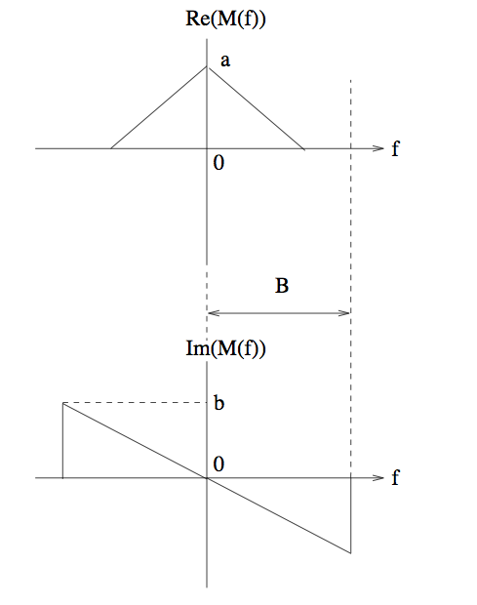
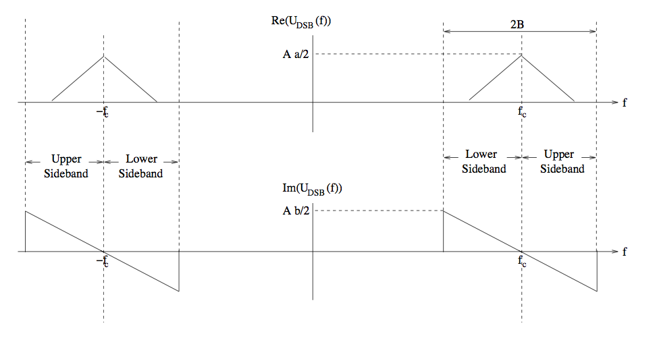
DSB ➔ SSB
Message signal
DSB signal

Slide 3
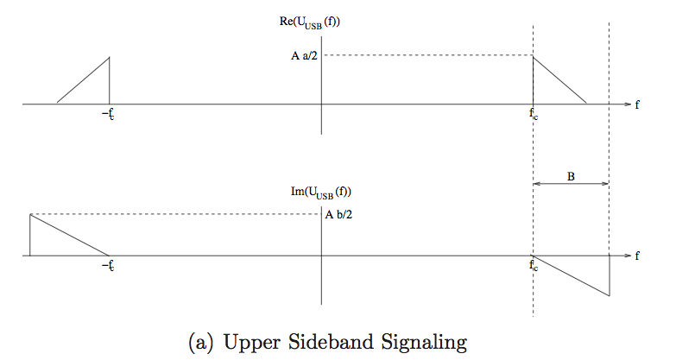
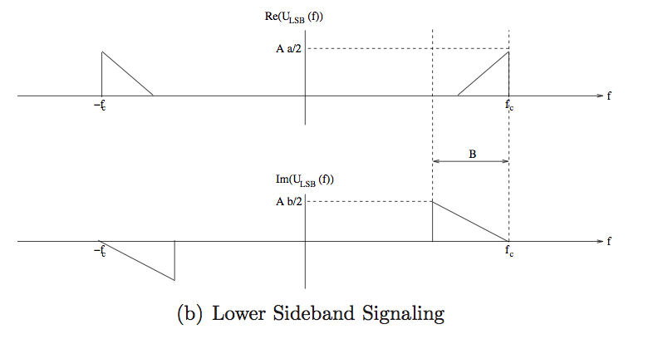
Single sideband (SSB)
Each sideband
has enough
info to reconstruct
the message
(Move in by f_{c}➔
extract I component)
Message is the I component of an SSB signal.
What is the Q component?

Slide 4
Single Sideband Modulation
In SSB modulation, we send either the upper sideband or the lower sideband of a DSB-SC signal.
Each sideband provides enough information to reconstruct the message. But how do we physically reconstruct the message from an SSB signal?
The baseband message can be reconstructed if we can move the component near +f_{c} to the left by f_{c}, and the component near −f_{c} to the right by f_{c}; that is, if we move in the passband components towards the origin.

Slide 5
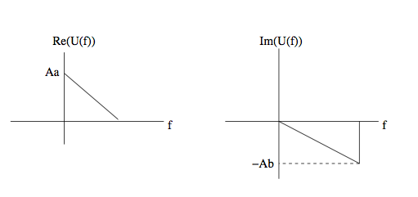
Complex envelope for SSB signal
USB passband
USB complex envelope

Slide 6
Complex Envelope of SSB Signal
To reconstruct the baseband message, we need to move the component near +f_{c} to the left by f_{c}, and the component near −f_{c} to the right by f_{c}. The frequency translations can be accomplished by multiplying the USB signal by 2cos(2πf_{c}t) = e^{j2fct} + e^{−j2fct}, which creates the desired message signal at baseband, as well as undesired frequency components at ±2f_{c} which can be rejected by a lowpass filter.
The same argument applies to LSB signals as well. SSB signals can be demodulated in exactly the same fashion as DSB-SC, using the coherent demodulator depicted. Demodulator simply extracts the I component of the passband signal, the I component of the SSB signal must be the message.

Slide 7
Complex Envelope of SSB Signal
The I And Q components can determined as:

Slide 8
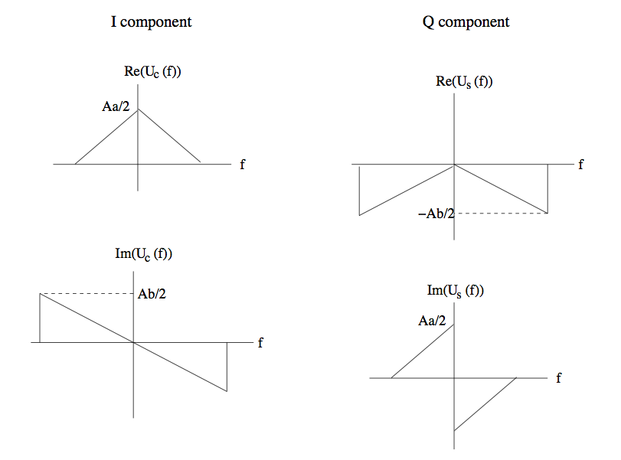
I and Q components for SSB
USB complex envelope
USB I and Q components

Slide 9
I and Q components for SSB
The I component U_{c}(f) = M(f), and the Q component is a transformation of given by
The Q component is a filtered version of the message, where the filter transfer function is H(f) = −jsgn(f). This transformation is given a special name, the Hilbert transform the message

Slide 10


Hilbert transform
(90 degree phase shift over all positive frequencies)

Slide 11
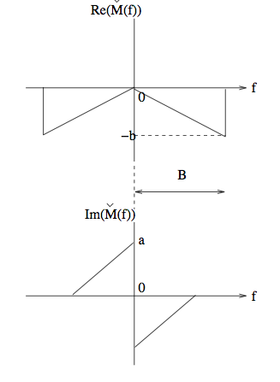
I component = message Q component = message Hilbert transform

Slide 12
Hilbert Transform
Physical interpretation of the Hilbert transform: If x(t) is real-valued, then so is its Hilbert transform ˇx(t). Thus, the Fourier transforms X(f) and ˇX (f) must both satisfy conjugate symmetry, and we only need to discuss what happens at positive frequencies.
For f > 0, we have
ˇX(f) = −jsgn(f)X(f) = −jX(f) = e^{−jπ/2}X(f). That is, the Hilbert transform simply imposes a π/2 phase lag at all (positive) frequencies, leaving the magnitude of the Fourier transform unchanged.

Slide 13
Hilbert Transform
These transforms effectively phase shift a function by 90 degrees independent of frequency. Hilbert transforms are useful in creating signals with one sided Fourier transforms.
90 Degree Phase Shifters: We need a function that will transform a sinusoid to another sinusoid with the same amplitude and frequency but simply phase shifted by 90 degrees.
cos(θ-90)=sin(θ); sin(θ-90)=-cos(θ)
We need the transform to do the following:
cos(θ) ➔sin(θ); sin(θ)➔-cos(θ)

Slide 14
Hilbert Transform
Fourier Transform pairs:
cos(2πf₀t) ⬅➔(δ(f-f₀)+δ(f+f₀))/2
sin(2πf₀t) ⬅➔(δ(f-f₀)-δ(f+f₀))/2j
The transform should such that
(δ(f-f₀)+δ(f+f₀))*H(f) = (δ(f-f₀)-δ(f+f₀))/j=-j* (δ(f-f₀)-δ(f+f₀))
(δ(f-f₀)-δ(f+f₀))*H(f) = -j*(δ(f-f₀)+δ(f+f₀))

Slide 15
Example
Based on the preceding argument, a sinusoid s(t) = cos(2πf₀t+φ) has Hilbert transform ˇs(t) = cos(2πf₀t+ φ− π/2 ) = sin(2πf₀t+φ).

Slide 16
Example
Based on the preceding argument, a sinusoid s(t) = cos(2πf₀t+φ) has Hilbert transform ˇs(t) = cos(2πf₀t+ φ− π/2 ) = sin(2πf₀t+φ).

Slide 17
I and Q components for SSB (repeat)
The I component U_{c}(f) = M(f), and the Q component is a transformation of given by
The Q component is a filtered version of the message, where the filter transfer function is H(f) = −jsgn(f). This transformation is given a special name, the Hilbert transform the message

Slide 18
Time domain representation of SSB signals
From the spectrum relationship, we have
U_{c}(f)=M(f)
U_{s}(f) = (-jsgn(f))M(f)
U(f)=U_{c}(f)+jU_{s}(f)
Complex Envelope: u(t) = u_{c}(t)+ju_{s}(t)
u_{p}(t)=u_{c}(t)cos(2πf_{c}t) – u_{s}(t)son(2πf_{c}t) (USB)
What about LSB?

Slide 19
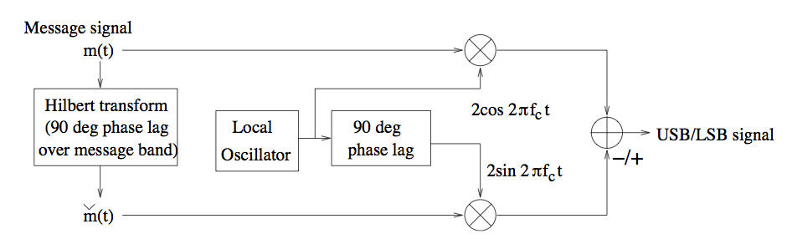
Implementing SSB in baseband
Implementing Hilbert transform in baseband avoids need
for sharp filtering at passband

Slide 20
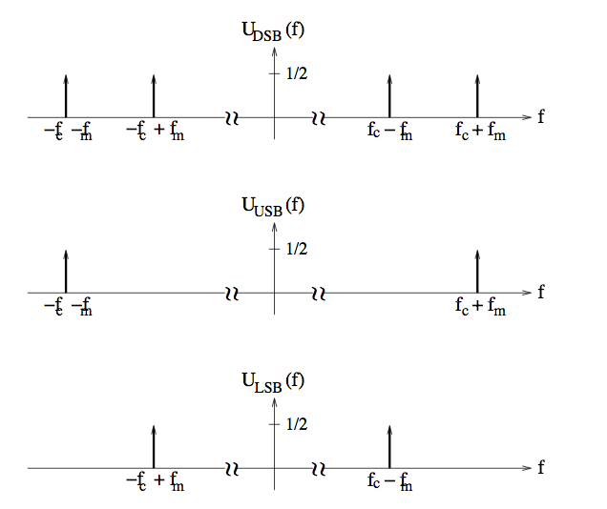
SSB for sinusoidal message

Slide 21


SSB demodulation
Synchronous demodulation to extract I component
Vulnerable to carrier phase offset
Passband received signal, phase offset wrt receiver LO
Complex envelope with respect to receiver LO
I component
attenuation
interference

Slide 22


SSB demodulation: non-coherent
Can add strong carrier component and employ envelope detection
SSB + strong carrier component
Message info preserved in envelope
as long as

Slide 23
VSB Modulation
VSB is similar to SSB, in that it also tries to reduce the transmitted bandwidth relative to DSB, and the transmitted signal is a filtered version of the DSB signal. The idea is to mainly transmit one of the two sidebands, but to leave a vestige of the other sideband in order to ease the filtering requirements.
The passband filter used to shape the DSB signal in this fashion is chosen so that the I component of the transmitted signal equals the message.
2m(t) cos 2πf_{c}t ↔ M(f − f_{c}) +M(f + f_{c})
This is filtered by a passband VSB filter with transfer function H_{p}(f), to obtain the transmitted signal with spectrum
U_{VSB}(f) = H_{p}(f) (M(f − f_{c}) +M(f + f_{c}))

Slide 24
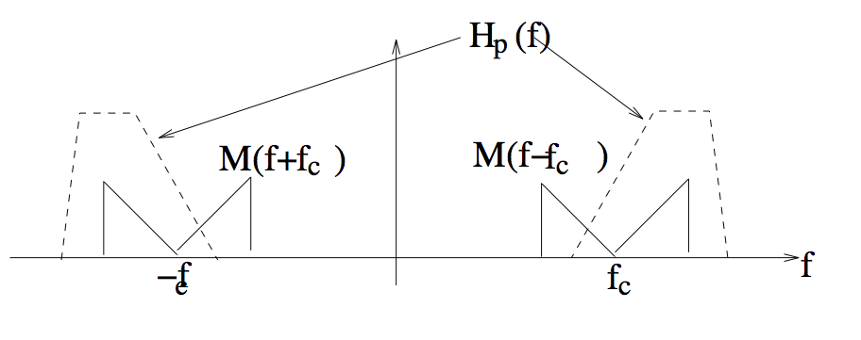
VSB signaling
Filter DSB signal so as to leave vestige of one sideband
(generalizes SSB)

Slide 25
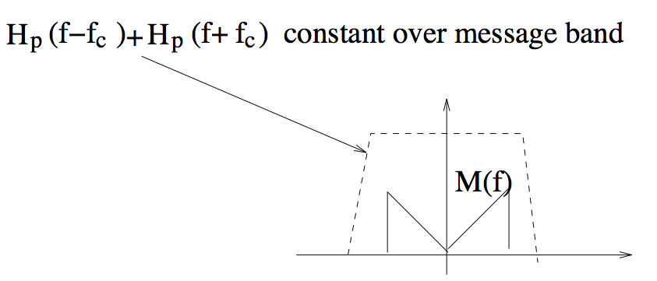
How to choose VSB filter
I component = message
Q component = filtered version
of message that cancels
portion of spectrum

Slide 26
Example
Problem 3.4 Consider a message signal m(t) = cos(2πfmt + φ), and a corresponding DSB-SC signal up(t) = Am(t) cos 2πfct, where fc > fm.
(a) Sketch the spectra of the corresponding LSB and USB signals (if the spectrum is complex valued, sketch the real and imaginary parts separately).
(b) Find explicit time domain expressions for the LSB and USB signals.

Slide 27
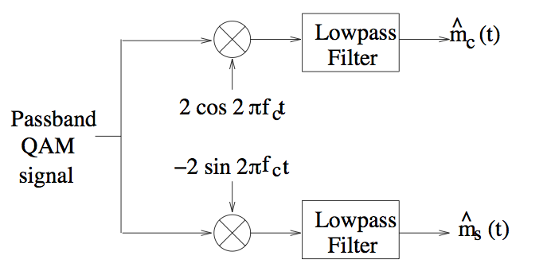
QAM signaling
Both I and Q components carry information
Standard practice in modern digital communication systems
Will see much more of this in Chapter 4 and beyond…

Slide 28

Carrier sync requirement for QAM
Complex envelope when there is phase offset wrt receiver LO
Effect of rotation on I and Q components
Phase offset typically estimated and corrected for
after downconversion in modern systems

Slide 29
Example

Slide 30



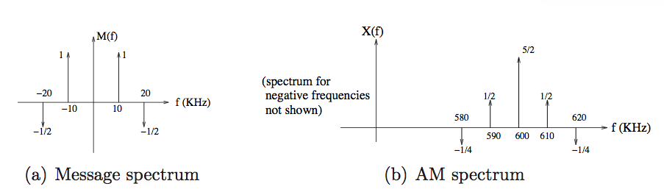
Example 3.2.4
Message signal
AM signal
(time in milliseconds, carrier frequency 600 KHz)
Magnitude spectrum and bandwidth of AM signal?

Slide 31
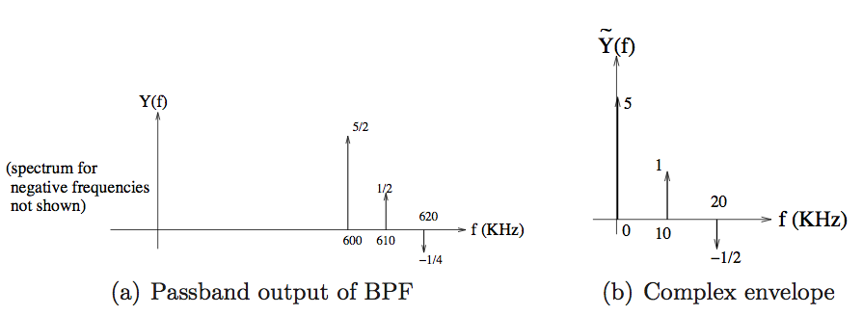


Example 3.2.4 contd.
AM signal passed through an ideal highpass filter with cut-off frequency 595 KHz.
Find explicit time domain expression for Q component of output (relative to 600 KHz
reference)
Easiest to just take inverse Fourier transform of complex envelope
(see text for alternative approaches)
Q component

